Slide 1
AI problems, foundation of AI and history of AI intelligent agents: Agents and Environments

Slide 2
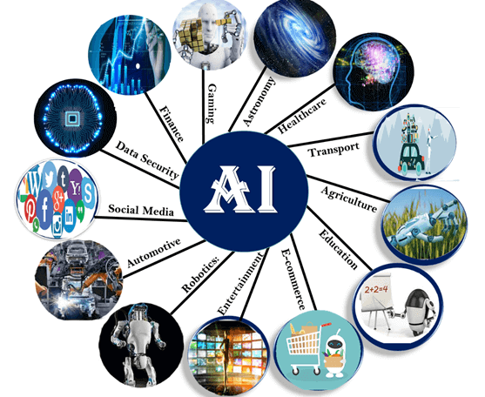
APPLICATIONS OF AI
Artificial Intelligence has various applications in today's society.
It is becoming essential for today's time because it can solve complex problems with an efficient way in multiple industries, such as Healthcare, entertainment, finance, education, etc.
AI is making our daily life more comfortable and fast.

Slide 3
AI in Astronomy
Artificial Intelligence can be very useful to solve complex universe problems.
AI technology can be helpful for understanding the universe such as how it works, origin, etc.
AI in Healthcare
In the last, five to ten years, AI becoming more advantageous for the healthcare industry and going to have a significant impact on this industry.
Healthcare Industries are applying AI to make a better and faster diagnosis than humans.
AI can help doctors with diagnoses and can inform when patients are worsening so that medical help can reach to the patient before hospitalization.

Slide 4
AI in Gaming
AI can be used for gaming purpose.
The AI machines can play strategic games like chess, where the machine needs to think of a large number of possible places.
AI in Finance
AI and finance industries are the best matches for each other.
The finance industry is implementing automation, chatbot, adaptive intelligence, algorithm trading, and machine learning into financial processes.

Slide 5
AI in Data Security
The security of data is crucial for every company and cyber-attacks are growing very rapidly in the digital world.
AI can be used to make your data more safe and secure. Some examples such as AEG bot, AI2 Platform,are used to determine software bug and cyber-attacks in a better way.
AI in Social Media
Social Media sites such as Facebook, Twitter, and Snapchat contain billions of user profiles, which need to be stored and managed in a very efficient way.
AI can organize and manage massive amounts of data. AI can analyze lots of data to identify the latest trends, hashtag, and requirement of different users.

Slide 6
AI in Travel & Transport
AI is becoming highly demanding for travel industries.
AI is capable of doing various travel related works such as from making travel arrangement to suggesting the hotels, flights, and best routes to the customers.
Travel industries are using AI-powered chatbots which can make human-like interaction with customers for better and fast response.
AI in Automotive Industry
Some Automotive industries are using AI to provide virtual assistant to their user for better performance.
Such as Tesla has introduced TeslaBot, an intelligent virtual assistant.
Various Industries are currently working for developing self-driven cars which can make your journey more safe and secure.

Slide 7
AI in Robotics:
Artificial Intelligence has a remarkable role in Robotics.
Usually, general robots are programmed such that they can perform some repetitive task, but with the help of AI, we can create intelligent robots which can perform tasks with their own experiences without pre-programmed.
Humanoid Robots are best examples for AI in robotics, recently the intelligent Humanoid robot named as Erica and Sophia has been developed which can talk and behave like humans.
AI in Entertainment
We are currently using some AI based applications in our daily life with some entertainment services such as Netflix or Amazon.
With the help of ML/AI algorithms, these services show the recommendations for programs or shows.

Slide 8
AI in Agriculture
Agriculture is an area which requires various resources, labor, money, and time for best result.
Now a day's agriculture is becoming digital, and AI is emerging in this field.
Agriculture is applying AI as agriculture robotics, solid and crop monitoring, predictive analysis. AI in agriculture can be very helpful for farmers.
AI in E-commerce
AI is providing a competitive edge to the e-commerce industry, and it is becoming more demanding in the e-commerce business.
AI is helping shoppers to discover associated products with recommended size, color, or even brand.
AI in education:
AI can automate grading so that the tutor can have more time to teach. AI chatbot can communicate with students as a teaching assistant.
AI in the future can be work as a personal virtual tutor for students, which will be accessible easily at any time and any place.

Slide 9
History of Artificial Intelligence
Artificial Intelligence is not a new word and not a new technology for researchers.
This technology is much older than you would imagine.
Even there are the myths of Mechanical men in Ancient Greek and Egyptian Myths.
Following are some milestones in the history of AI which defines the journey from the AI generation to till date development.

Slide 10
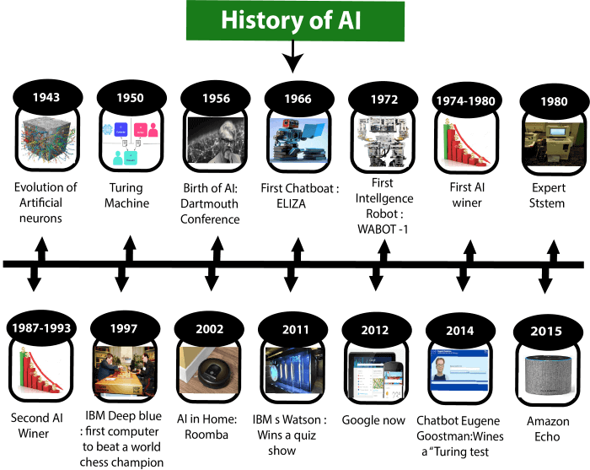

Slide 11
Maturation of Artificial Intelligence (1943-1952)
Year 1943: The first work which is now recognized as AI was done by Warren McCulloch and Walter pits in 1943. They proposed a model of artificial neurons.
Year 1949: Donald Hebb demonstrated an updating rule for modifying the connection strength between neurons. His rule is now called Hebbian learning.
Year 1950: The Alan Turing who was an English mathematician and pioneered Machine learning in 1950. Alan Turing publishes "Computing Machinery and Intelligence" in which he proposed a test.
The test can check the machine's ability to exhibit intelligent behavior equivalent to human intelligence, called a Turing test.

Slide 12
The birth of Artificial Intelligence (1952-1956)
Year 1955: An Allen Newell and Herbert A. Simon created the "first artificial intelligence program"Which was named as "Logic Theorist". This program had proved 38 of 52 Mathematics theorems, and find new and more elegant proofs for some theorems.
Year 1956: The word "Artificial Intelligence" first adopted by American Computer scientist John McCarthy at the Dartmouth Conference. For the first time, AI coined as an academic field.
At that time high-level computer languages such as FORTRAN, LISP, or COBOL were invented. And the enthusiasm for AI was very high at that time.

Slide 13
The golden years-Early enthusiasm (1956-1974)
Year 1966: The researchers emphasized developing algorithms which can solve mathematical problems. Joseph Weizenbaum created the first chatbot in 1966, which was named as ELIZA.
Year 1972: The first intelligent humanoid robot was built in Japan which was named as WABOT-1.
The first AI winter (1974-1980)
The duration between years 1974 to 1980 was the first AI winter duration.
AI winter refers to the time period where computer scientist dealt with a severe shortage of funding from government for AI researches.
During AI winters, an interest of publicity on artificial intelligence was decreased.

Slide 14
A boom of AI (1980-1987)
Year 1980: After AI winter duration, AI came back with "Expert System". Expert systems were programmed that emulate the decision-making ability of a human expert.
In the Year 1980, the first national conference of the American Association of Artificial Intelligence was held at Stanford University.
The second AI winter (1987-1993)
The duration between the years 1987 to 1993 was the second AI Winter duration.
Again Investors and government stopped in funding for AI research as due to high cost but not efficient result. The expert system such as XCON was very cost effective.

Slide 15
The emergence of intelligent agents (1993-2011)
Year 1997: In the year 1997, IBM Deep Blue beats world chess champion, Gary Kasparov, and became the first computer to beat a world chess champion.
Year 2002: for the first time, AI entered the home in the form of Roomba, a vacuum cleaner.
Year 2006: AI came in the Business world till the year 2006. Companies like Facebook, Twitter, and Netflix also started using AI.
Deep learning, big data and artificial general intelligence (2011-present)
Year 2011: In the year 2011, IBM's Watson won jeopardy, a quiz show, where it had to solve the complex questions as well as riddles. Watson had proved that it could understand natural language and can solve tricky questions quickly.
Year 2012: Google has launched an Android app feature "Google now", which was able to provide information to the user as a prediction.
Year 2014: In the year 2014, Chatbot "Eugene Goostman" won a competition in the infamous "Turing test.“
Year 2018: The "Project Debater" from IBM debated on complex topics with two master debaters and also performed extremely well.

Slide 16
Google has demonstrated an AI program "Duplex" which was a virtual assistant and which had taken hairdresser appointment on call, and lady on other side didn't notice that she was talking with the machine.
Now AI has developed to a remarkable level.
The concept of Deep learning, big data, and data science are now trending like a boom.
Nowadays companies like Google, Facebook, IBM, and Amazon are working with AI and creating amazing devices.
The future of Artificial Intelligence is inspiring and will come with high intelligence.

Slide 17
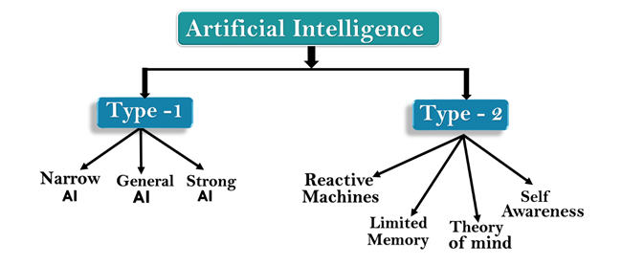
TYPES OF ARTIFICIAL INTELLIGENCE

Slide 18
AI type-1: Based on Capabilities
Weak AI or Narrow AI:
Narrow AI is a type of AI which is able to perform a dedicated task with intelligence.
The most common and currently available AI is Narrow AI in the world of Artificial Intelligence.
Narrow AI cannot perform beyond its field or limitations, as it is only trained for one specific task. Hence it is also termed as weak AI.
Narrow AI can fail in unpredictable ways if it goes beyond its limits.
Apple Siriis a good example of Narrow AI, but it operates with a limited pre-defined range of functions.
IBM's Watson supercomputer also comes under Narrow AI, as it uses an Expert system approach combined with Machine learning and natural language processing.
Some Examples of Narrow AI are playing chess, purchasing suggestions on e-commerce site, self-driving cars, speech recognition, and image recognition.

Slide 19
General AI:
General AI is a type of intelligence which could perform any intellectual task with efficiency like a human.
The idea behind the general AI to make such a system which could be smarter and think like a human by its own.
Currently, there is no such system exist which could come under general AI and can perform any task as perfect as a human.
The worldwide researchers are now focused on developing machines with General AI.
As systems with general AI are still under research, and it will take lots of efforts and time to develop such systems.

Slide 20
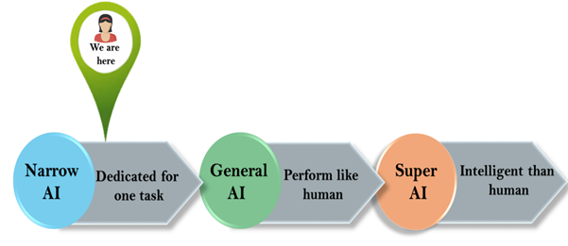
Super AI:
Super AI is a level of Intelligence of Systems at which machines could surpass human intelligence, and can perform any task better than human with cognitive properties. It is an outcome of general AI.
Some key characteristics of strong AI include capability include the ability to think, to reason,solve the puzzle, make judgments, plan, learn, and communicate by its own.
Super AI is still a hypothetical concept of Artificial Intelligence. Development of such systems in real is still world changing task.

Slide 21
Artificial Intelligence type-2: Based on functionality
1. Reactive Machines
Purely reactive machines are the most basic types of Artificial Intelligence.
Such AI systems do not store memories or past experiences for future actions.
These machines only focus on current scenarios and react on it as per possible best action.
IBM's Deep Blue system is an example of reactive machines.
Google's AlphaGo is also an example of reactive machines.

Slide 22
Limited Memory
Limited memory machines can store past experiences or some data for a short period of time.
These machines can use stored data for a limited time period only.
Self-driving cars are one of the best examples of Limited Memory systems. These cars can store recent speed of nearby cars, the distance of other cars, speed limit, and other information to navigate the road.
Theory of Mind
Theory of Mind AI should understand the human emotions, people, beliefs, and be able to interact socially like humans.
This type of AI machines are still not developed, but researchers are making lots of efforts and improvement for developing such AI machines.

Slide 23
Self-Awareness
Self-awareness AI is the future of Artificial Intelligence. These machines will be super intelligent, and will have their own consciousness, sentiments, and self-awareness.
These machines will be smarter than human mind.
Self-Awareness AI does not exist in reality still and it is a hypothetical concept.

